Slide 1
Information Briefing
On Accessing the DLA Internet Bid Board (DIBBS), Collaboration Folders & Export Control Technical Data
December 2024
Unclassified

Slide 2
Agenda
DLA Internet Bid Board (DIBBS) Registration
Accessing DLA Technical Data Repository (cFolders)
Accessing DLA Export Control Technical Data
Useful Links
Unclassified

Slide 3
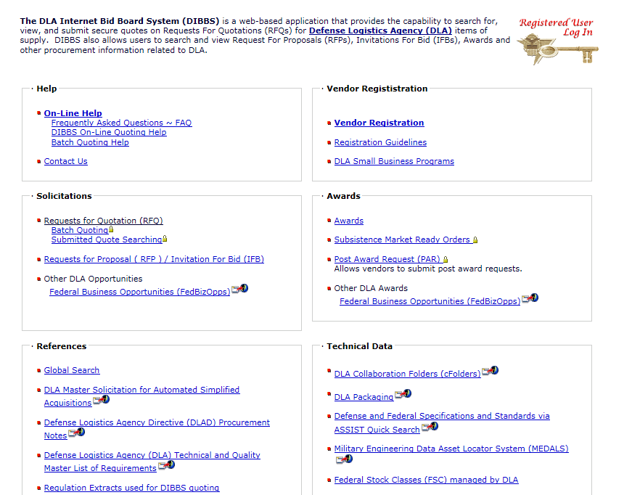

DLA Internet Bid Board (DIBBS)
Unclassified

Slide 4
DIBBS Registration Steps
Register in System for Award Management (SAM) (www.sam.gov)
DIBBS CAGE code entry (DIBBS will prefill company data entered in SAM)
Physical mailing address verification (post card mailed to address entered in SAM)
User personal data entry for the DIBBS account administrator/Super User
Email Personal Identification Number (PIN) verification
Physical address verification number request and entry
Accept DIBBS user agreement
Create password
Create challenge questions & responses
Complete supplier information
Review and submit
Completion of registration
E-mail dibbsbsm@dla.mil for questions
Unclassified

Slide 5

DIBBS Terms of Use
To avoid disrupting in accessing DIBBS be aware of the DIBBS Terms of Use:
Reasonable suspicion that a vendor’s account has been compromised or is being used to adversely impact the automated procurement system.
Sharing account information with unregistered and/or unauthorized users.
Any violation of these terms and conditions.
Use of data, accessed through DLA systems, in violation of the Export Administration Regulations (EAR) and/or International Traffic in Arms Regulations (ITAR).
Material misrepresentation made in DIBBS.
A vendor fails to comply with the requirements, when applicable, regarding controlled technical information and covered defense information as set forth in DFARS clauses 252.204-7008, 525.204-7009, 252.204-7012, 252.204-7019, 252.204-7020, and 252.204-7021.
A vendor fails to provide required documentation requested by a contracting officer under any purchase order (e.g., FAR 52.246-2, Procurement Note C03), necessary to validate contractor information submitted in DIBBS.
WARFIGHTERALWAYS
Unclassified
5

Slide 6
Accessing Technical Data in cFolders
Technical data (i.e. technical drawings) for open DLA solicitations are posted to DLA’s Collaboration Folders (cFolders)
To access cFolders, suppliers will need to first obtained a DLA Internet Bid Board (DIBBS) account. Upon creation of a DIBBS account, suppliers can then establish a cFolders account
To establish a cFolders account go to the DIBBS Home Page, select the DLA Collaborations Folder link https://pcf1x.bsm.dla.mil/cfolders/ and follow the instructions for establishing a cFolders password and user ID
Upon cFolders account creation, suppliers have access to non-restricted tech data
Unclassified
Notes:
Speaker- Luis

Slide 7
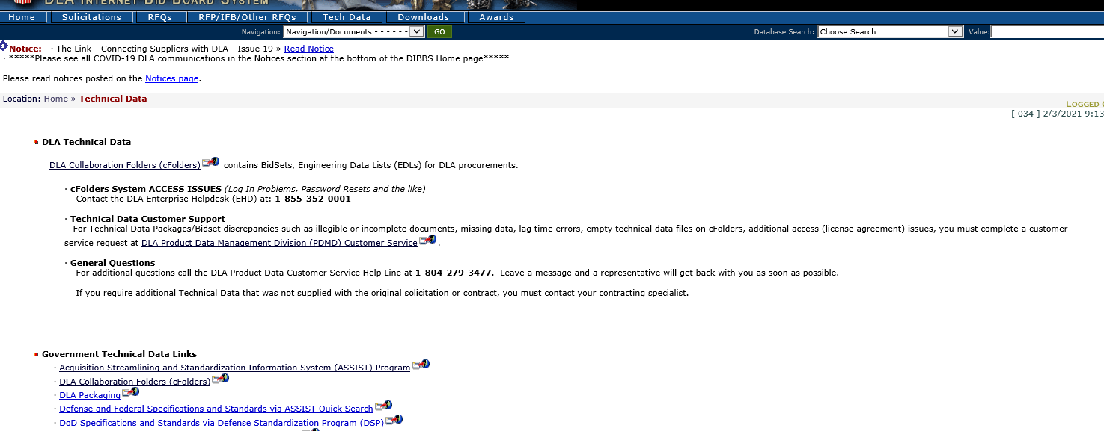
Accessing cFolders through DIBBS
Visit:
https://www.dibbs.bsm.dla.mil/Refs/TechData/
Click on “DLA Collaboration Folders (cFolders)”
Unclassified
Notes:
Speaker- Luis

Slide 8
Accessing Restricted
Export-Controlled Technical Data in cFolders
Have an approved CAGE Code.
Have an approved DIBBS account with an enabled DLA technical data distribution system (cFolders) account https://pcf1x.bsm.dla.mil/cfolders/.
Have National Institute of Standards and Technology (NIST) Special Publication (SP) 800-171 cybersecurity assessment documented on the Supplier Performance Risk System (SPRS) at https://www.sprs.csd.disa.mil/
Have an approved Joint Certification Program (JCP) certification (DD Form 2345) JCP Home (dla.mil).
Obtain Enhanced JCP (EJCP) approval https://www.dla.mil/HQ/LogisticsOperations/EnhancedValidation/.
  Complete the “DLA Introduction to Proper Handling of DoD Export-Controlled Technical Data Training.”
  Complete the “DLA Export-Controlled Technical Data Management Questionnaire.”
  Return the training certificate and completed questionnaire to the JCP Office at JCP-ADMIN@DLA.MIL.
  E-mail DLAJ344DataCustodian@dla.mil for questions.
Unclassified

Slide 9
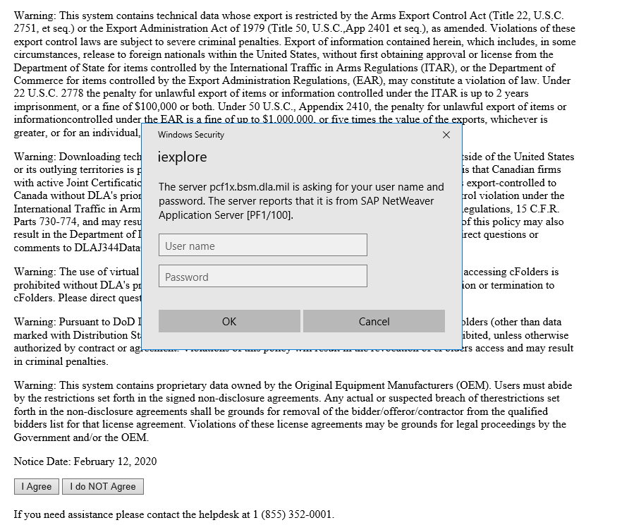
cFolders Terms of Use
Warning Disclosures
*Read all cFolders Terms of Use Warning disclosures closely. If you agree with the disclosures, you will be prompted for a User name and password (required to access the data).*
As part of DLA’s cybersecurity, DLA monitors cFolders activity. To avoid having your cFolders account suspended please comply with the Warning disclosures.
Unclassified
Notes:
Speaker- Luis

Slide 10
Useful Links
GSA System for Award Management: https://sam.gov/SAM/
DoD CAGE Code Program: https://cage.dla.mil/
DLA Internet Bid Board (DIBBS): https://www.dibbs.bsm.dla.mil/
DLA Export Control Data Program Instructions: https://www.dla.mil/HQ/LogisticsOperations/EnhancedValidation/
Joint Certification Program Office: JCP Home (dla.mil)
SPRS Supplier Performance Risk System (disa.mil)
Unclassified

Slide 11

Questions
Unclassified

